Slide 1
Shell Scripting
Week 2 Lecture 2.2

Slide 2
Grep examples

Slide 3
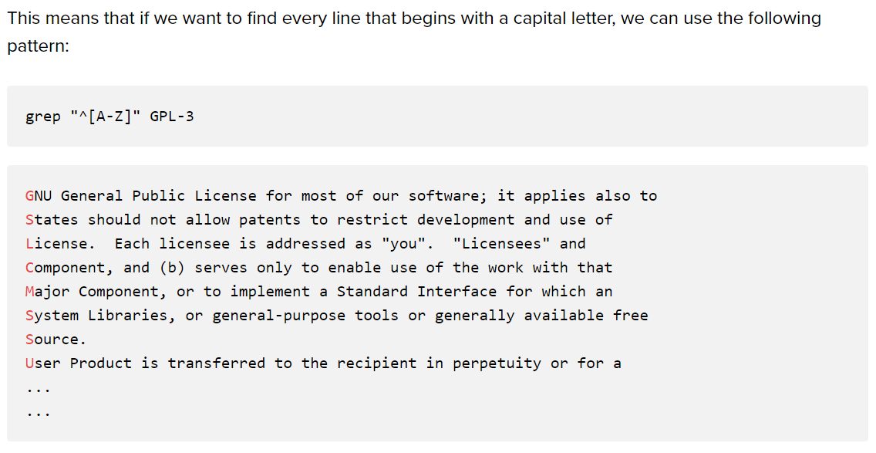

Slide 4
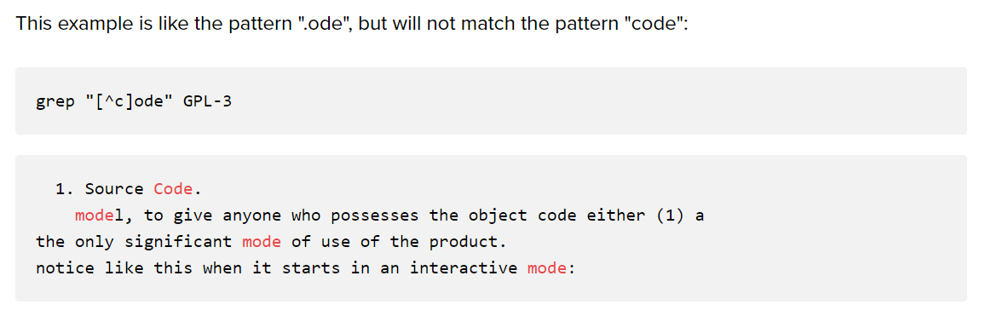

Slide 5
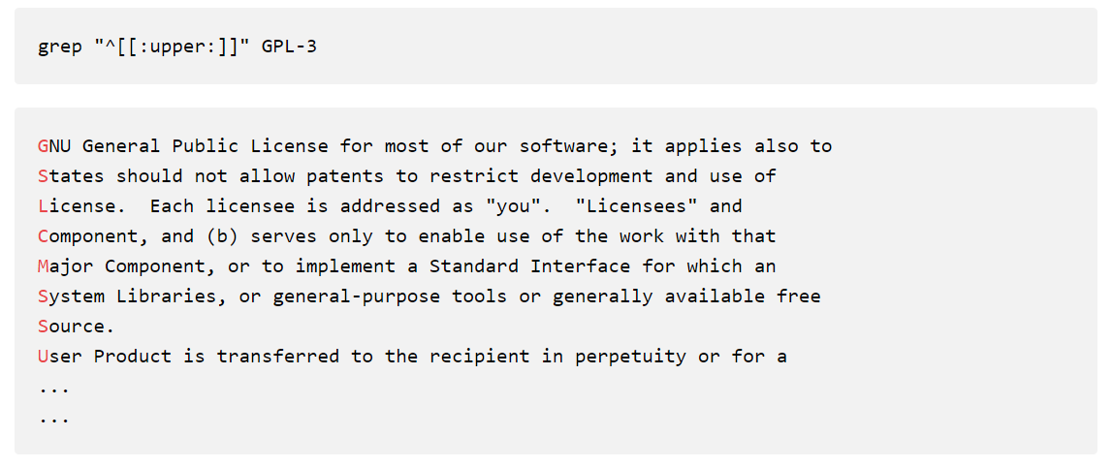

Slide 6
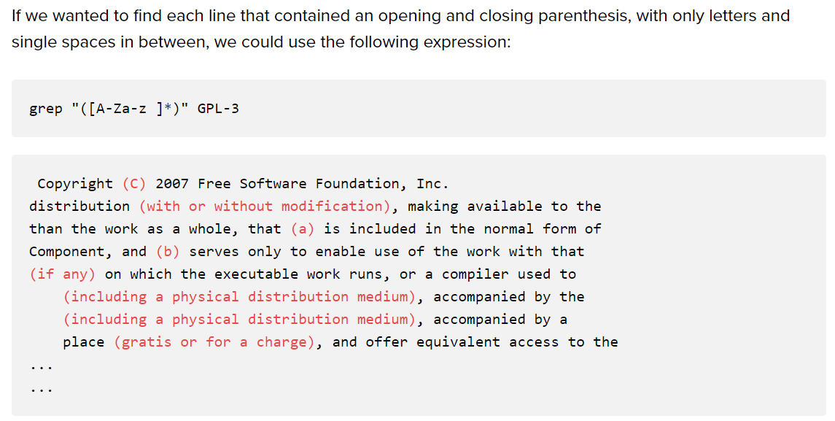

Slide 7
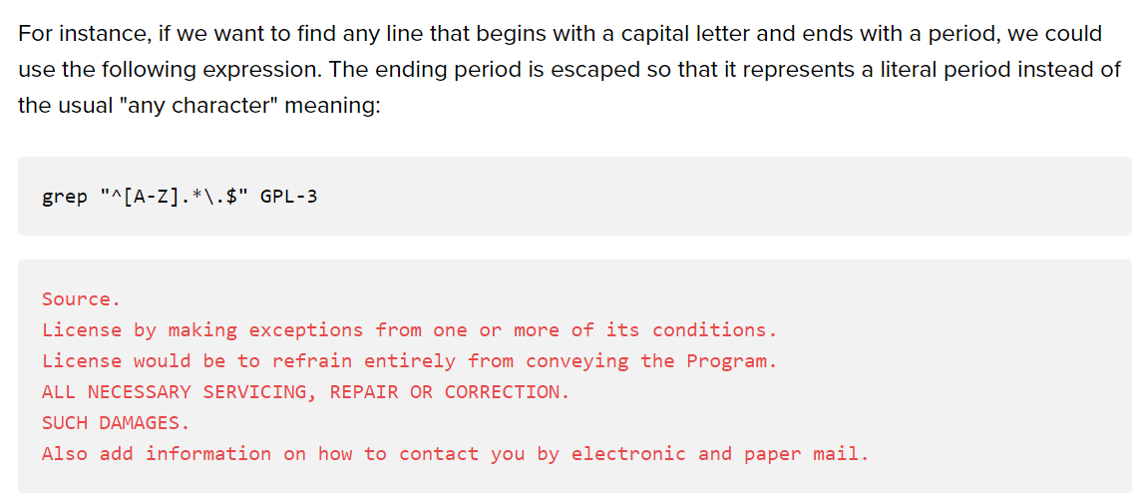

Slide 8
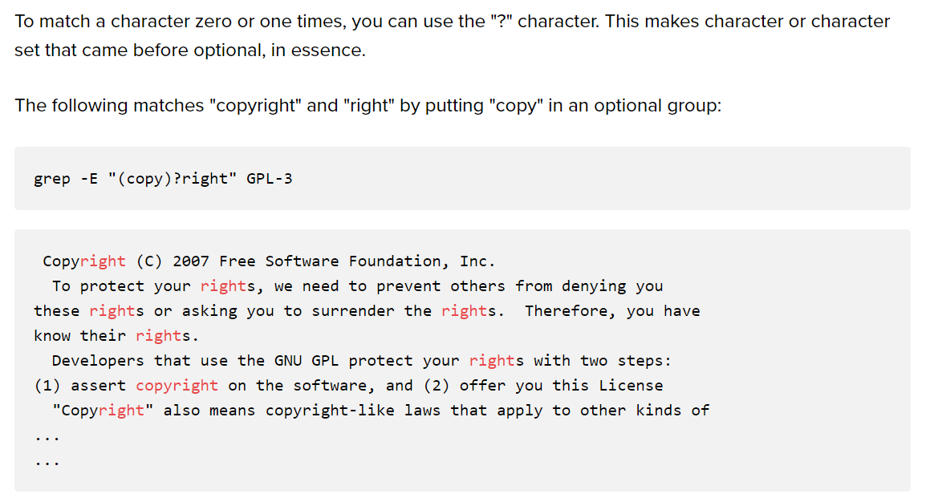

Slide 9
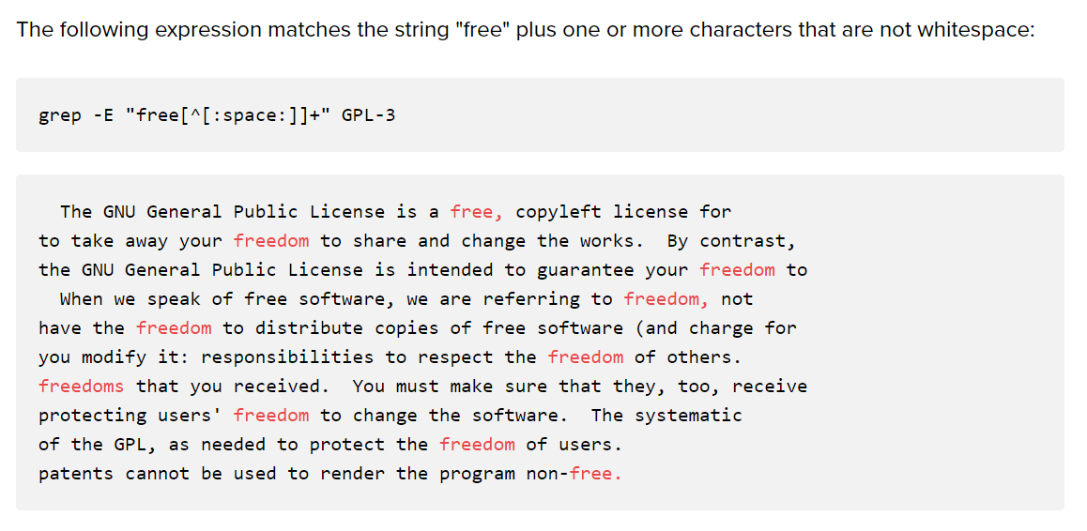

Slide 10
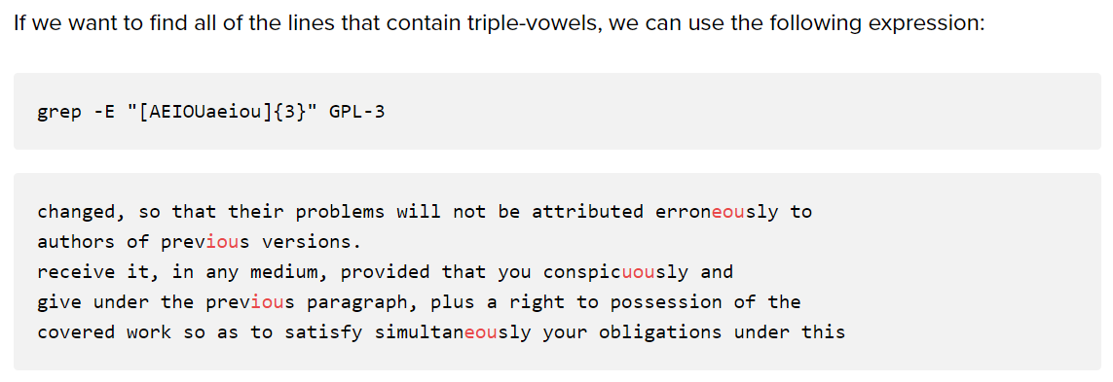

Slide 11
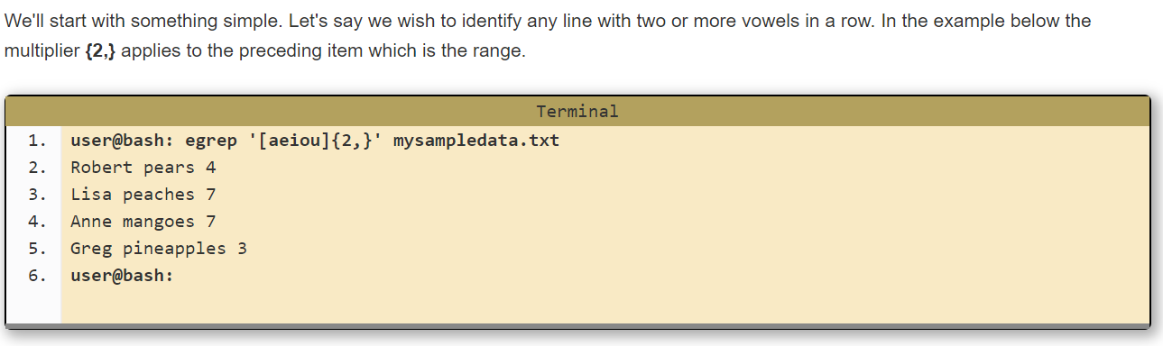

Slide 12
Output?
File names.txt
Fred apples 20 Anne mangoes 7 Greg pineapples 3 Betty limes 14 Zeesha bananas 22 Sarah cherries 1
egrep '^[^A-K]' names.txt
  Ans: Lines starting with anything except uppercase A-K
egrep '^[A-K]' names.txt
  Ans: Lines starting with uppercase A-K

Slide 13
Task 3 and 4
Get all files using find which have a number in their names using grep
  Find . –type f | grep [0-9]
List all directories using ls
  ls -d */
Exclude all lines that begin with a-z/A-Z
  grep “________” filename
  grep “^[^a-zA-Z]” filename

Slide 14
Anchoring text matches
Pattern | Text matched (in bold) / Reason match fails
ABC | Characters 4, 5, and 6, in the middle: abcABCdefDEF
^ABC | Match is restricted to beginning of string
def | Characters 7, 8, and 9, in the middle: abcABCdefDEF
def$ | Match is restricted to end of string
[[:upper:]]\{3\} | Characters 4, 5, and 6, in the middle: abcABCdefDEF
[[:upper:]]\{3\}$ | Characters 10, 11, and 12, at the end: abcDEFdefDEF
^[[:alpha:]]\{3\} | Characters 1, 2, and 3, at the beginning: abcABCdefDEF

Slide 15
Phew!
grep –E 'l*' f?.txt : prints all lines in the text files which have ‘l’ 0 or more times (technically, print everything :P). The files considered start with ‘f’ followed by only one character/number.
grep –E ‘l.*’ f*.txt : prints all lines in the text files which have ‘l’ for sure, followed by any character 0 or more times. The files considered start with ‘f’ followed by any character/number.
grep –E ‘l+' f?.txt : prints all lines in the text files which have ‘l’ 1 or more times.
grep –E ‘l.+' f?.txt : prints all lines in the text files which have ‘l’ for sure, followed by any character 1 or more times.
grep –E ‘l?' f?.txt : prints all lines in the text files which have ‘l’ or don’t have ‘l’ (Comment: ‘?’ is like binary, something exists or does not)
grep –E ‘l.?' f?.txt : prints all lines in the text files which have ‘l’ for sure followed/not followed by any character

Slide 16
Trial (Regex vs filename globbing)
Find command does not support regex but it has its own use of ‘?’ and ‘*’
  ?: matches any single character in a filename [Note: in regex ‘.?’ this means any character appears or does not]
  *: matches one or more characters in a filename
find . -name 'f?.txt’: finds file which have this format f<char>.txt
find . -name ‘f??.txt’: finds file which have this format f<char><char>.txt

Slide 17
Example
Print the lines which have ‘line’ from text files which start with f using regex
  grep -E ‘line' `(ls | grep ‘^f’)`
  Format grep <pattern> <file>

Slide 18
Text Processing Tools
sort: sorts text
wc: outputs a one-line report of lines, words, and bytes
lpr: sends files to print queue
head: extract top of files
tail: extracts bottom of files

Slide 19
sed
Now you can extract, but what if you want to replace parts of text?
Use sed!
sed ‘s/regExpr/replText/’
Example
sed 's/:.*//' /etc/passwd
Removes everything after the first colon

Slide 20
More on Variables
Read only command
hours_per_day=24 seconds_per_hour=3600 days_per_week=7 Assign values
readonly hours_per_day seconds_per_hour days_per_week Make read-only
Export: puts variables into the environment, which is a list of name-value pairs that is available to every running program
PATH=$PATH:/usr/local/bin Update PATH
export PATH Export it
env: used to remove variables from a program’s environment or temporarily change environment variable values
unset: remove variable and functions from the current shell

Slide 21
Parameter Expansion
Process by which the shell provides the value of a variable for use in the program
reminder="Time to go to the dentist!" Save value in reminder variable
sleep 120 Wait two minutes
echo $reminder Print message

Slide 22
Pattern–matching operators
path=/home/tolstoy/mem/long.file.name
Operator | Substitution
${variable#pattern} | If the pattern matches the beginning of the variable's value, delete the shortest part that matches and return the rest.
Example: ${path#/*/} | Result: tolstoy/mem/long.file.name
${variable##pattern} | If the pattern matches the beginning of the variable's value, delete the longest part that matches and return the rest.
Example: ${path##/*/} | Result: long.file.name
${variable%pattern} | If the pattern matches the end of the variable's value, delete the shortest part that matches and return the rest.
Example: ${path%.*} | Result: /home/tolstoy/mem/long.file
${variable%%pattern} | If the pattern matches the end of the variable's value, delete the longest part that matches and return the rest.
Example: ${path%%.*} | Result: /home/tolstoy/mem/long

Slide 23
String Manipulation
${string:position}: Extracts substring from $string at $position
${string:position:length} Extracts $length characters of substring $string at $position
${#string}: Returns the length of $string

Slide 24
POSIX Built-in Shell Variables
Variable | Meaning
# | Number of arguments given to current process.
@ | Command-line arguments to current process. Inside double quotes, expands to individual arguments.
* | Command-line arguments to current process. Inside double quotes, expands to a single argument.
- (hyphen) | Options given to shell on invocation.
? | Exit status of previous command.
$ | Process ID of shell process.
0 (zero) | The name of the shell program.
! | Process ID of last background command. Use this to save process ID numbers for later use with the wait command.
ENV | Used only by interactive shells upon invocation; the value of $ENV is parameter-expanded. The result should be a full pathname for a file to be read and executed at startup. This is an XSI requirement.
HOME | Home (login) directory.
IFS | Internal field separator; i.e., the list of characters that act as word separators. Normally set to space, tab, and newline.
LANG | Default name of current locale; overridden by the other LC_* variables.
LC_ALL | Name of current locale; overrides LANG and the other LC_* variables.
LC_COLLATE | Name of current locale for character collation (sorting) purposes.
LC_CTYPE | Name of current locale for character class determination during pattern matching.
LC_MESSAGES | Name of current language for output messages.
LINENO | Line number in script or function of the line that just ran.
NLSPATH | The location of message catalogs for messages in the language given by $LC_MESSAGES (XSI).
PATH | Search path for commands.
PPID | Process ID of parent process.
PS1 | Primary command prompt string. Default is "$ ".
PS2 | Prompt string for line continuations. Default is "> ".
PS4 | Prompt string for execution tracing with set -x. Default is "+ ".
PWD | Current working directory.

Slide 25
Arithmetic Operators
Operator | Meaning | Associativity
++ -- | Increment and decrement, prefix and postfix | Left to right
+ - ! ~ | Unary plus and minus; logical and bitwise negation | Right to left
* / % | Multiplication, division, and remainder | Left to right
+ - | Addition and subtraction | Left to right
<< >> | Bit-shift left and right | Left to right
< <= > >= | Comparisons | Left to right
= = != | Equal and not equal | Left to right
& | Bitwise AND | Left to right
^ | Bitwise Exclusive OR | Left to right
| | Bitwise OR | Left to right
&& | Logical AND (short-circuit) | Left to right
|| | Logical OR (short-circuit) | Left to right
?: | Conditional expression | Right to left
= += -= *= /= %= &= ^= <<= >>= |= | Assignment operators | Right to left

Slide 26
Exit: Return value
Value | Meaning
0 | Command exited successfully.
> 0 | Failure during redirection or word expansion (tilde, variable, command, and arithmetic expansions, as well as word splitting).
1-125 | Command exited unsuccessfully. The meanings of particular exit values are defined by each individual command.
126 | Command found, but file was not executable.
127 | Command not found.
> 128 | Command died due to receiving a signal.

Slide 27
if-elif-else-fi
if condition
then
statements-if-true-1
[ elif condition
then
statements-if-true-2
... ]
[ else
statements-if-all-else-fails ]
fi

Slide 28
Example
if grep pattern myfile > /dev/null
then
... Pattern is there
else
... Pattern is not there
fi

Slide 29
Bash For Loop using “in” and list of values
Method 1:
for varname in list
do
command1
command2
..
done
Method 2:
for (( expr1; expr2; expr3 ))
do
command1
command2
..
done

Slide 30
Example
$ cat for1.sh
i=1
for day in Mon Tue Wed Thu Fri
do
echo "Weekday $((i++)) : $day"
done
$ bash for1.sh
Weekday 1 : Mon
Weekday 2 : Tue
Weekday 3 : Wed
Weekday 4 : Thu
Weekday 5 : Fri

Slide 31
while
while condition
do
statements
done

Slide 32
break and continue
Pretty much the same as in C/C++

Slide 33
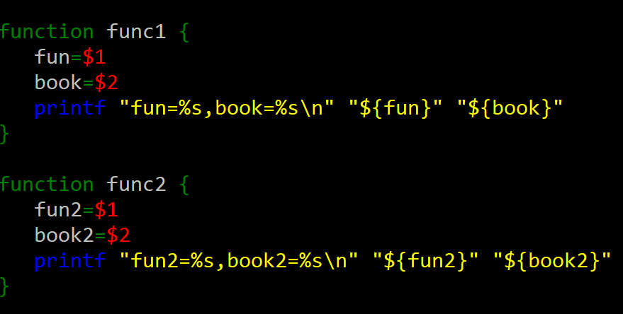
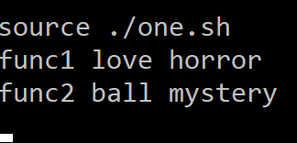
Functions
Must be defined before they can be used
Can be done either at the top of a script or by having them in a separate file and source them with the “dot” (.) command.
One.sh two.sh

Slide 34
# wait_for_user --- wait for a user to log in
#
# usage: wait_for_user user [ sleeptime ]
wait_for_user ( ) {
until who | grep "$1" > /dev/null
do
sleep ${2:-30}
done
}
Functions are invoked the same way a command is
wait_for_user tolstoy Wait for tolstoy, check every 30 seconds
wait_for_user tolstoy 60 Wait for tolstoy, check every 60 seconds
The position parameters ($1, $2, etc) refer to the function’s arguments.
The return command serves the same function as exit and works the same way
answer_the_question ( ) {
...
return 42
}

Slide 35
Functions
function( ) {
while ……
do
echo $1
…….
done
}
Functions are invoked the same way a command is:
Function Hi

Slide 36
Example:
#this is like a cpp function void func($1 $2) {} where $1 $2 are arguments of this function func_abc
  func_abc(){
  echo $1 #first argument of function echo $2 #second argument of function }
  func_abc $2 $1 #function call, passing command line arguments as function #arguments
#My bash command to run this file is bash func.sh cs35L ucla
Syntax: bash <filename> <commandline arg1> <commandline arg2> ….
Output:
ucla
cs35L

Slide 37
Shell Script – Using Arguments
#!/bin/bash # example of using arguments to a script echo "My first name is $1" echo "My surname is $2" echo "Total number of arguments is $#" Save as name.sh Output: $ chmod +777 name.sh $ ./name.sh Hans-Wolfgang Loidl #to execute the file My first name is Hans-Wolfgang My surname is Loidl Total number of arguments is 2

Slide 38
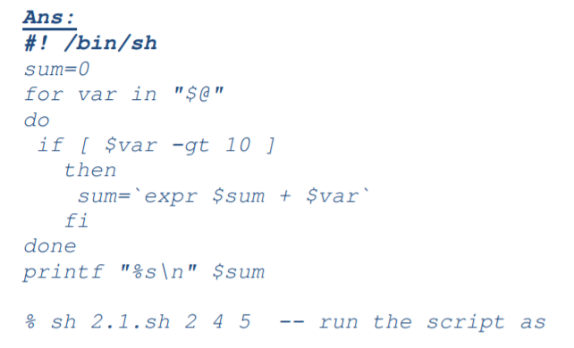
Task 5
Write a shell script sum.sh that takes an unspecified number of command line arguments (up to 9) of ints and finds their sum. Modify the code to add a number to the sum only if the number is greater than 10

Slide 39
Task 6
Write a shell script takes the name a path (eg: /afs/andrew/course/15/123/handin), and counts all the sub directories (recursively)
#!/bin/bash
ls –lR $1| grep ^d | wc -l
bash file.sh /afs/andrew/course/15/123/handin

Slide 40
Other tasks
Link (page 12 - )

Slide 41
Extra: awk command
awk is a utility/language designed for data extraction
top | awk '{print $1,$3}’ Print only columns one and three using stdin
awk '/pattern/{print $2}’ Print only elements from column 2 that match pattern using stdin
Link: http://bit.ly/awk_

Slide 42
The Basics: Links
ln : creates a link
  Hard links : Point to physical Data
    Does not create a new inode for a file
  Additional name for an existing file
    ln file1 hlink1
  Soft Links/ Symbolic Links (-s): Point to file
    Creates a new inode for a file
    It is a link to another name in the file system
    ln –s <source file> <my file>
  When we create a hard link, we create another direct link to that data/inode; when we create a soft link, we only make a link with the file name, and where it is.
  If the source file is removed, the soft link is useless, the hard link will remain
  Unlike a hard link, a symbolic link does not contain the data in the target file.

Slide 43
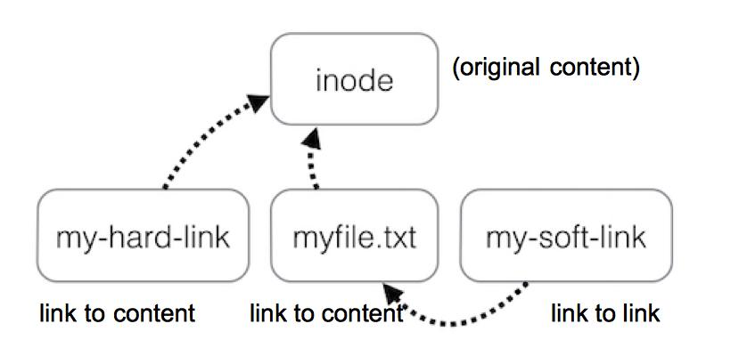
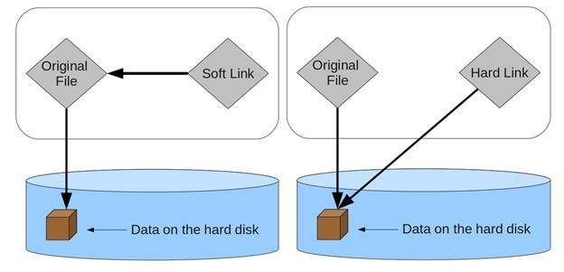

Slide 44
HW 2
Hawaiian.html -> buildwords -> hwords
Buildwords
  Read from STDIN and perform work on input
  Output to STDOUT
Ex:
  $ ./buildwords < hawaiian.html > hwords

Slide 45
HW 2…
Extract lines which contain words (Hint: <td> tag)
Get lines with Hawaiian words
  Even numbered lines
sed 's/<[^>]*>//g' a.html to remove all HTML tags
Remove leading space
  sed 's/^\s*//g’ (\s denotes space)
Substitute space in between words to newline
Delete all commas
Delete entries which have any character other than Hawaiian
Sort unique

